Slide 1
Indirect Inelastic

Slide 2
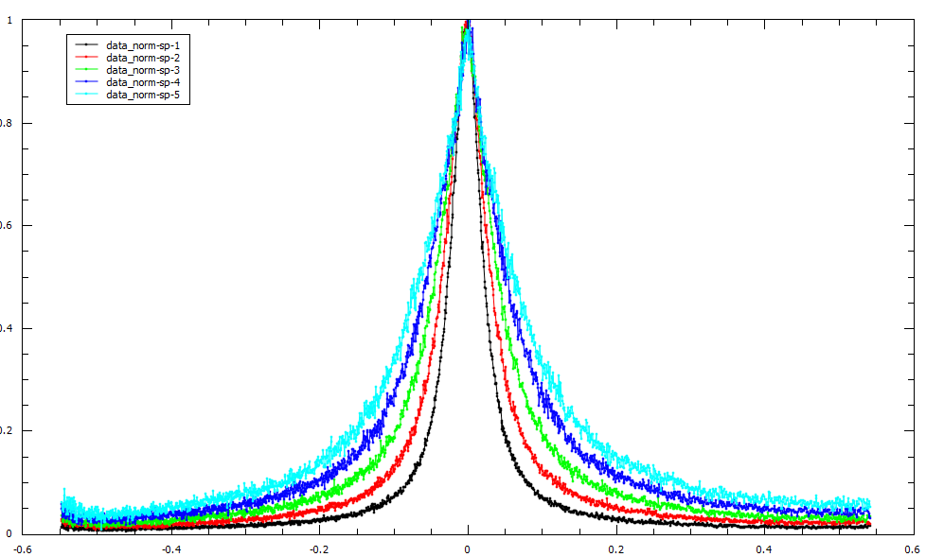
Algorithms and General
IqtFitSequential and IqtFitMultiple converted to Mantid algorithms
NormaliseSpectra
new algorithm to scale
workspace to peak height of 1
SaveAscii SpectrumMetaData
“Angle,Q,SpectrumNumber”
Python export for quickConversion
energy = UnitFactory.Instance().create("Energy")
wavelength = UnitFactory.Instance().create("Wavelength")
factor, power = energy.quickConversion("Wavelength")

Slide 3
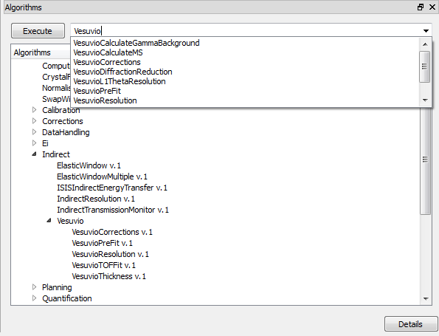
Vesuvio
Integration of algorithms
Load 2 and 3 period data
Validation of differencing vs. period vs. scattering when loading
VesuvioThickness algorithm
All algorithms prefixed with Vesuvio
Fit function for Multivariate Gaussian profile
Automatic testing of all algorithms and the workflow script
VesuvioCorrections fitting no longer gets stuck
Vesuvio Intensity Constraints passed correctly

Slide 4
Bug Fixes and interface improvements
Interface Range bars correctly updating throughout
SimulatedDensityOfStates rebins data correctly
Validation for Emin/Emax input
Corrections interfaces container plotting in miniplot
Plot spectra option in S(Q, ω) no longer causes crash
Rebinning in Calibration interface
Remove interface automatic running
BayesQuasi interface now crops to avoid 0s in data

Slide 5
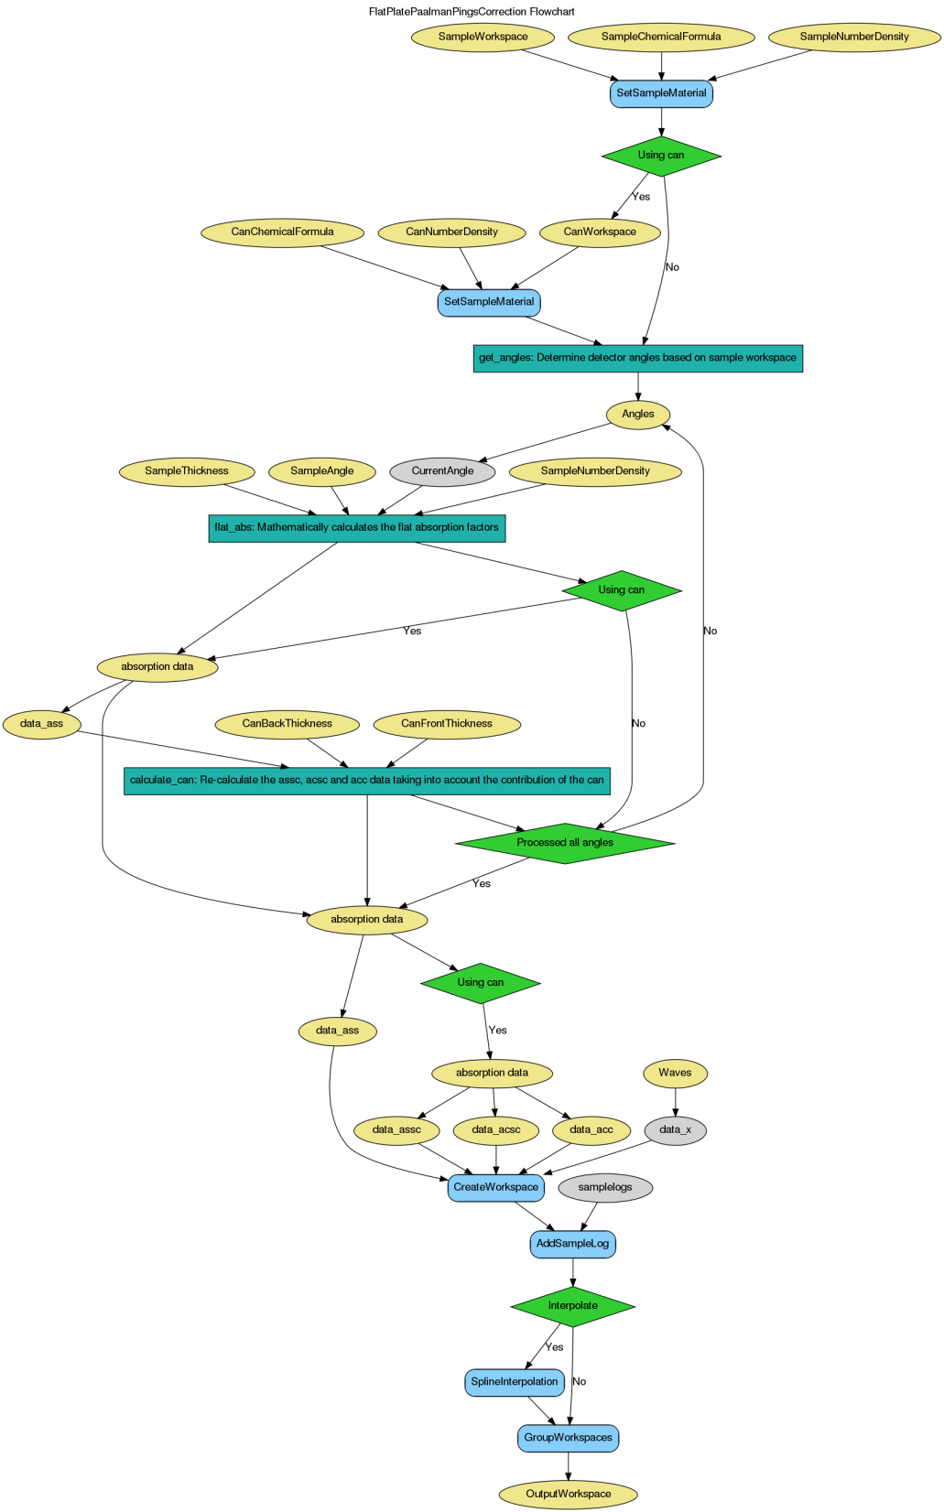
Documentation
Workflow diagrams
IqtFitMultiple
IqtFitSequential
OSIRISDiffractionReduction
ProcessIndirectFitParameters
SimulatedDensityOfStates
FlatPlatePaalmanPingsCorrection
BayesQuasi documentation displaying correctly online

